Slide 1

Market-in-Talk
Electricity Market in Discussions, Documents, and Rules

Slide 2
Types of Market Rule Documents
Nodal Protocol
Market Guides
Commercial Operations Market Guide (COMG)
Data Transport Guides (DTG)
Load Profiling Guide (LPG)
Nodal Operating Guide (NOG)
Operating Guides (OG)
Planning Guide (PG)
Retail Market Guide (RMG)
Settlement Metering Operating Guide (SMOG)
Texas Standard Electronic Transaction Guide (TSETG)
Verifiable Cost Manual (VCM)
Business Practice Manual
AS Market Transactions in DA and RT Adjust Period
COP Practices by QSE
DAM Operating Procedure Manual
ERCOT Market Notice Communication Process
ERCOT and QSE Operations Practices during the Operating Hour
Network Operations Modeling Expectations for TSPs, Res, and QSEs
Price Validation and Corrections
Simple Transmission Outage Definition
Split Generation Resources
Other Binding Documents
Demand Response Data Definitions and Technical Specifications
ERS Procurement Methodology
ERS Technical Requirements & Scope of Work
Methodologies for Determining Ancillary Service Requirements
Methodology for Implementing ORDC to Calculate Real-Time Reserve Price Adder
Nodal Non-Spinning Reserve Service Deployment Procedures
Operating Procedures
Procedure for Identifying Resource Nodes
Requirements for Aggregate Load Resource Participation
Resource Registration Glossary (RRG)
Texas Market Test Plan
Transmission Element Naming Convention
Key Principles
RTC
Key Topics & Concepts
BESS
ADER Pilot

Slide 3
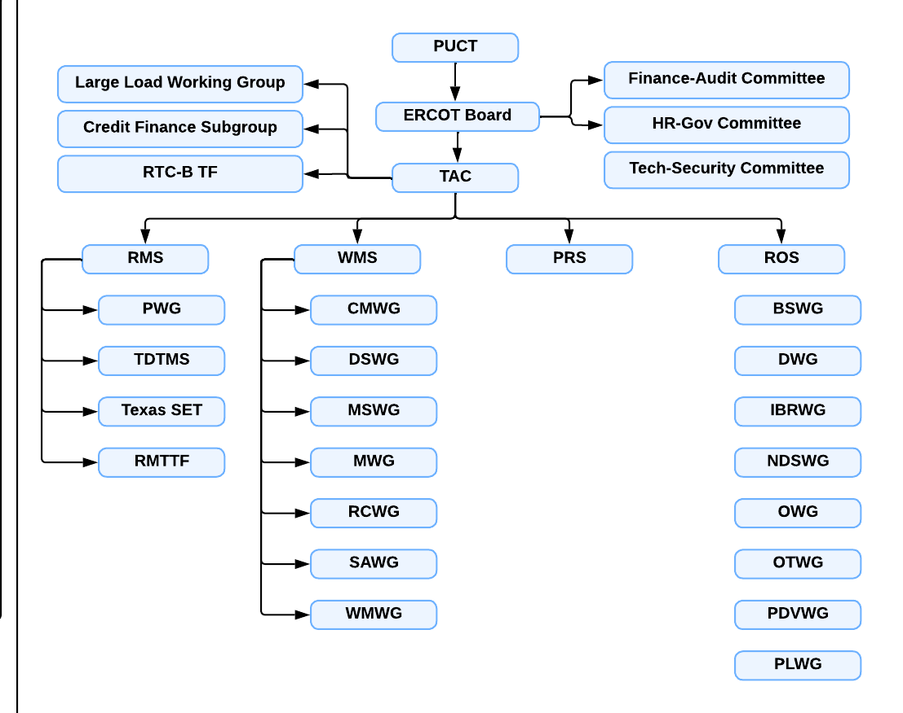
Note:
WG – working group
TF – Tasking Force
S – Sub-committee

Slide 4
Types of Market Rule Revision Requests
NPRR
VCMRR
SCR
OBDRR
COMGRR
LPGRR
NOGRR
PGRR
RMGRR
SMOGRR

Slide 5
Formats of Files
Revision Request Proposal
Format: MS Word
Presentation Slides
Format: MS PowerPoint
Numerical Examples
Format: MS Excel, csv
Notes
Format: txt

Slide 6
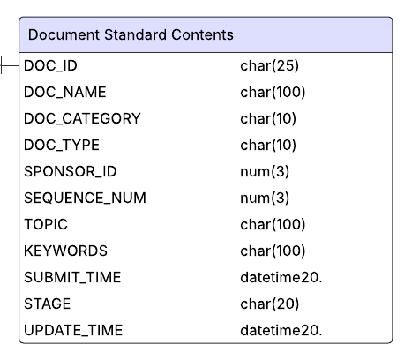
Revision Request
Title
Category: initial/comment/report
Sponsor
Organization
Author
Submit Time
Theme
Topic
Key words
Related Market Rule Documents
Protocol Section
Binding Documents
Stakeholder Stage
Meeting Time
Meeting Name

Slide 7
Market
in
Talk
Login
Enroll
Nodal Protocol
PUCT
Nodal Market Guides
Board of Directors
Business Practice Manuals
TAC
Other Binding Documents
PRS
ROS
WMS
RMS
Key Principles & Concepts
Large Load Working Group
Large Load Working Group
Large Load Working Group
Large Load Working Group
Large Load Working Group
Large Load Working Group
Large Load Working Group
Large Load Working Group
Large Load Working Group
Large Load Working Group
Large Load Working Group
Large Load Working Group
Large Load Working Group
Large Load Working Group
Large Load Working Group
Large Load Working Group
Large Load Working Group
Large Load Working Group
Large Load Working Group
Large Load Working Group
Large Load Working Group
Large Load Working Group
Large Load Working Group
Large Load Working Group

